Slide 1

Development of an E-Commerce Web Application “Total Mart”
Group A
PG-DAC
CDAC Kolkata

Slide 2

Group Details
Project Team
Sumeet Mukund Alhat (220970620043)
Vishal Prakash Shinde (220970620023)
Sumedh Deelip Zavare (220970620020)
Vaibhav Shankar Kale (220970620049)
Chinmay Pramod Patil (220970620050)
Sourav Santosh Shinde (220970620031)
Swapnil Bhaskar Bokade (220970620048)
Simran Salim Shaikh (220970620053)
Project Guide
Mr. Debdulal Basak
Joint Director
C-DAC, Kolkata

Slide 3
Group contribution
Team member | Front end | Back end | Testing
Sumeet Alhat | Spring Boot Setup Software Architecture Team Lead | REST API | Postman
Simran Shaikh | Static Pages, CSS styling
Vishal Shinde | Fetching API response from back end
Sumedh Zavare | Product components
Swapnil Bokade | User components
Sourav |  | Database model, Model Class
Chinmay Patil | Manual Testing | Resources collections, Project Management, | Manual Testing
Vaibhav Kale |  | Spring Data JPA

Slide 4
About Total Mart
An E-commerce web application is used for buying and selling of goods and services over an electronic systems such as the internet and other computer network.
Total Mart is an e-commerce website from where people can buy products online.
Admin monitors the activity of the users and checks the transactions.

Slide 5
Content
Scope of Work
Technologies
ER Diagram
Use Case Diagram
Class Diagram
Features of Total Mart
Future Work
Conclusion
References

Slide 6
Scope of Work
Admin has access to manage categories of product and products to be add.
Customer can view product and can add it to cart and can view ordered details.
Admin can view all order details and assign delivery person.
Delivery person is able to update delivery status which can be viewed by admin as well customer.

Slide 7
Technologies
Backend :- Spring Boot (Spring Data JPA, Rest API)
Frontend :- React JS, Bootstrap
Project Management :- Maven
Server :- Embedded Tomcat Server
Database :- MySQL Database

Slide 8
Technologies
Spring Boot Framework
Spring Boot is an open source Java-based framework used to create a micro Service. It is developed by Pivotal Team and is used to build stand-alone and production ready spring applications.
React JS
ReactJS is a declarative, efficient, and flexible JavaScript library for building reusable UI components. It is an open-source, component-based front end library which is responsible only for the view layer of the application. It was initially developed and maintained by Facebook and later used in its products like WhatsApp & Instagram.
MySQL Database
MySQL is a widely used relational database management system (RDBMS). MySQL is free and open-source. MySQL is ideal for both small and large applications.

Slide 9
Maven
Maven is a software project management and comprehension tool. Based on the concept of a project object model (POM), Maven can manage a project's build, reporting and documentation from a central piece of information

Slide 10
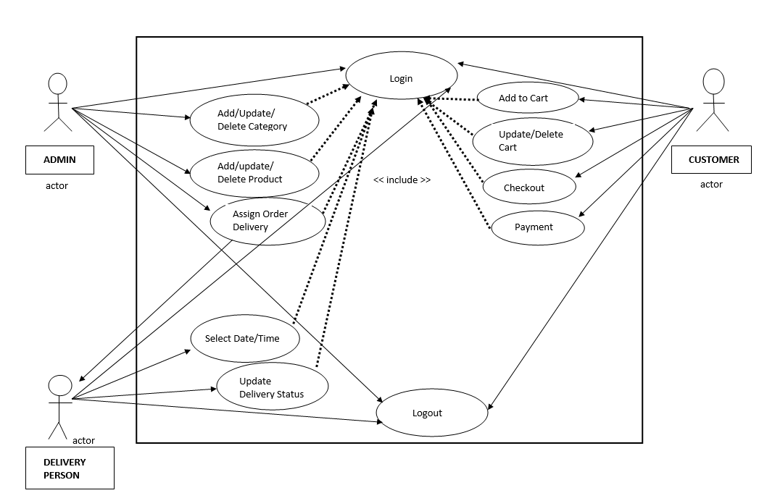
Use Case Diagram

Slide 11
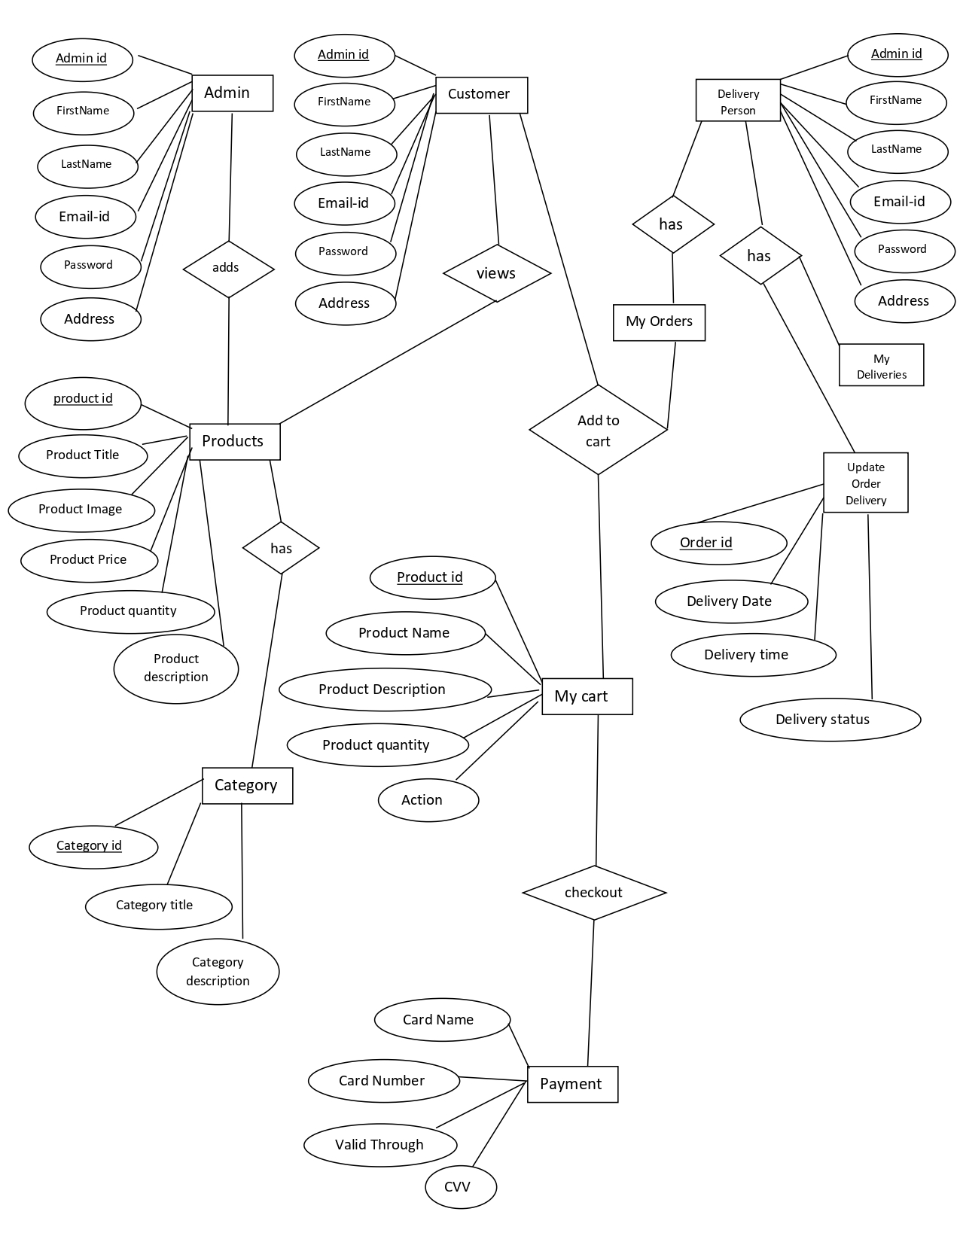
ER Diagram

Slide 12
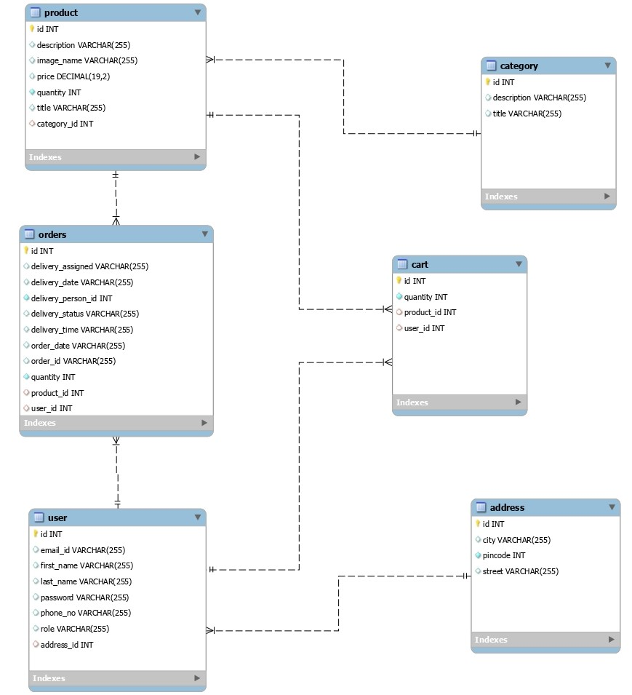
Class Diagram

Slide 13
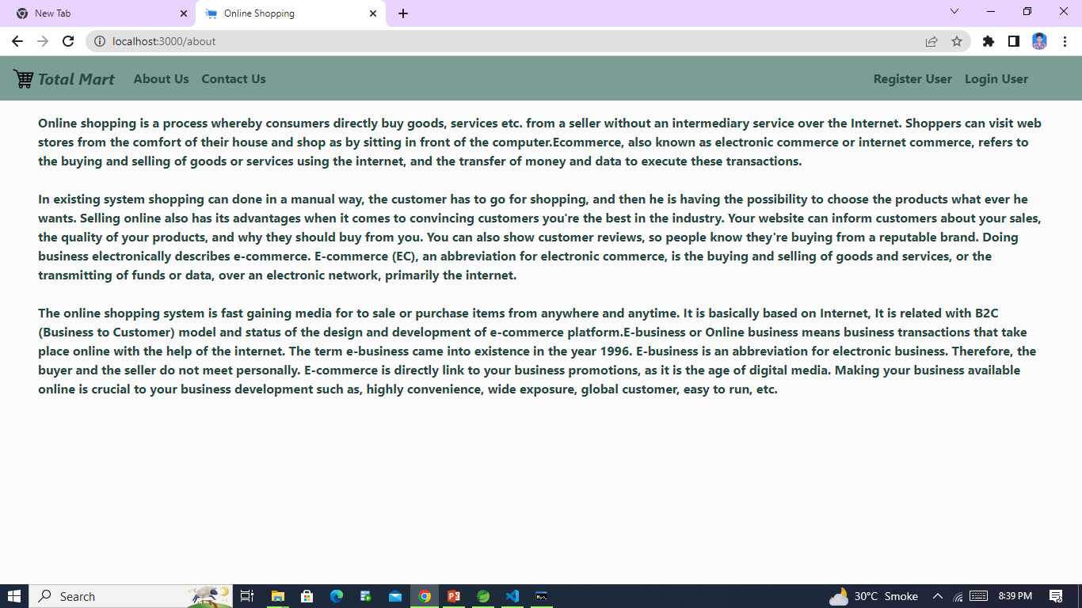
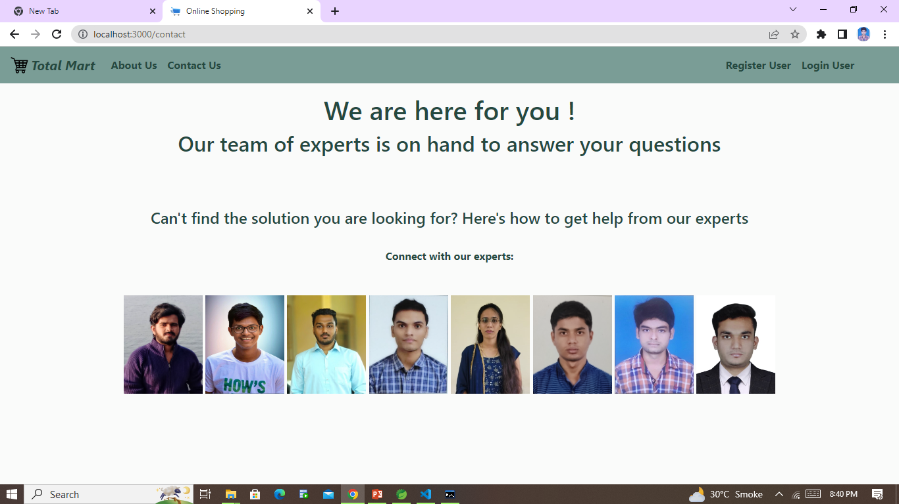
Features of Total Mart
Some static pages of Total-Mart

Slide 14
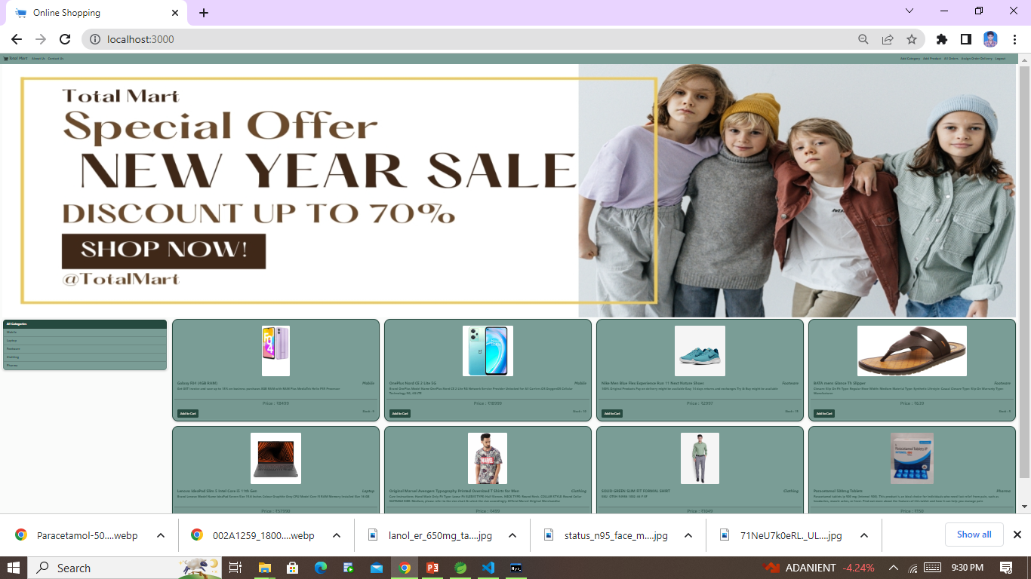
The Home Page of Total-Mart

Slide 15
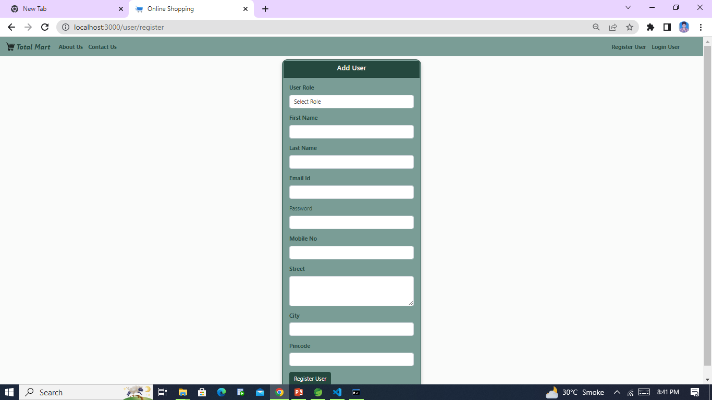
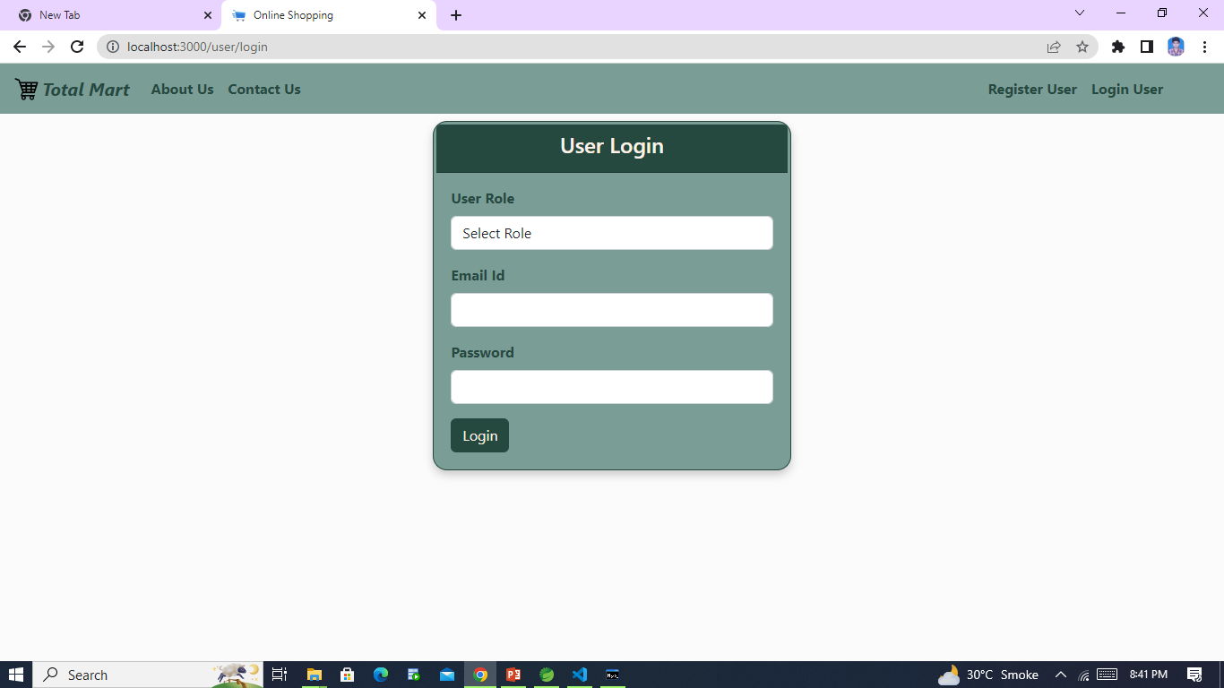
Register and Login Page

Slide 16

Admin login.

Slide 17
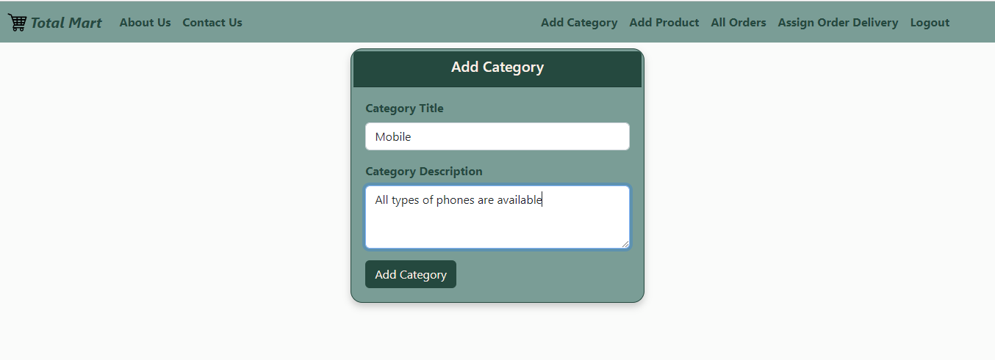
Add Category Option.

Slide 18
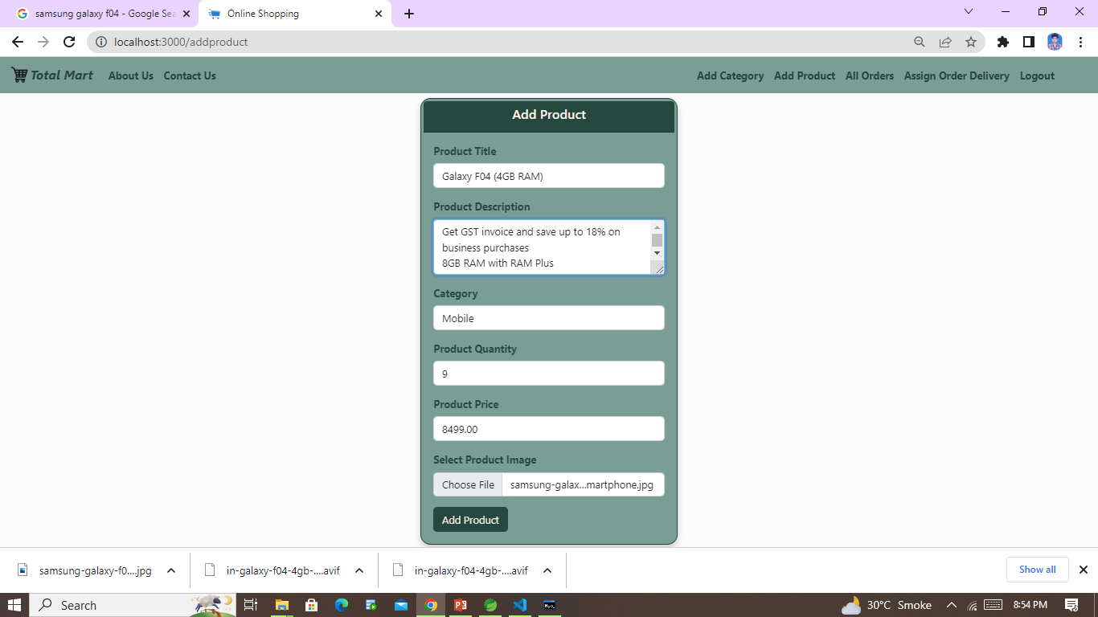
Admins can add products.

Slide 19
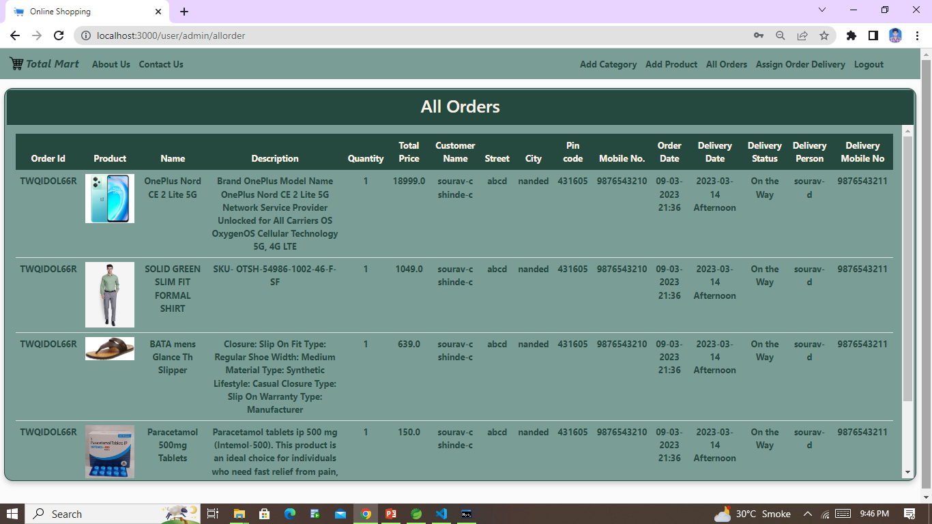
view all order details and assign delivery.

Slide 20
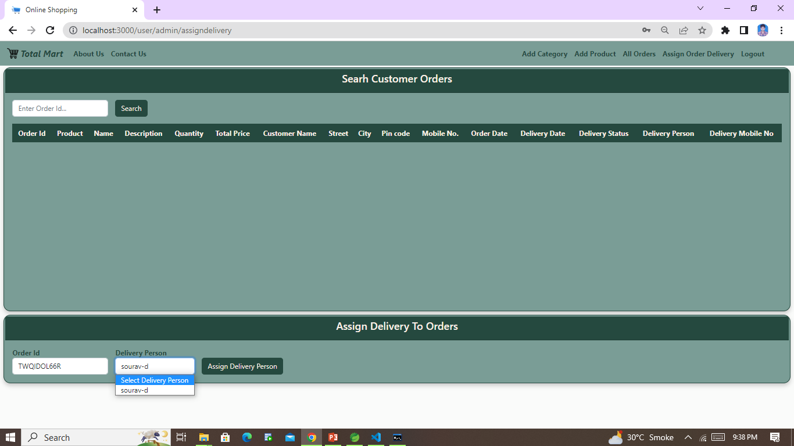
Admin assigning order delivery to delivery person

Slide 21
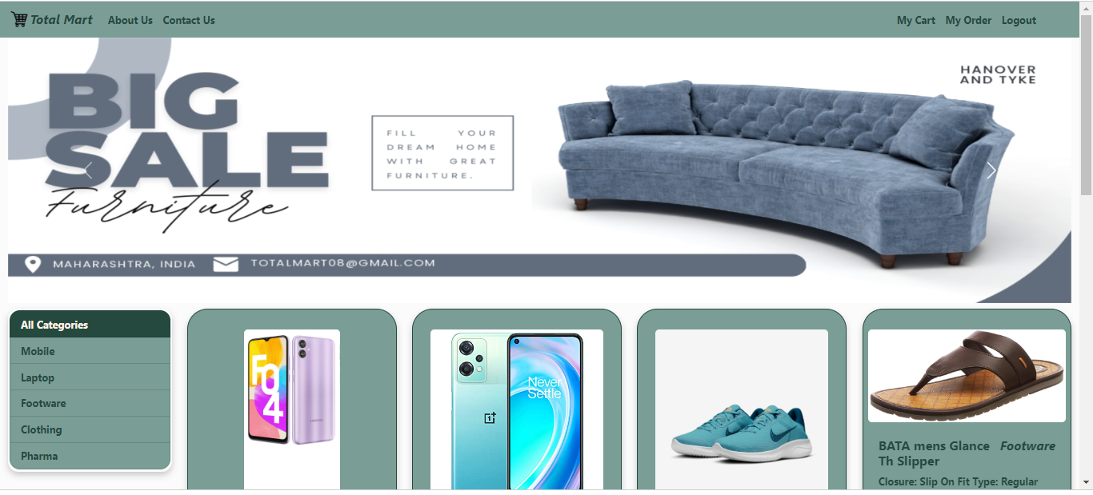
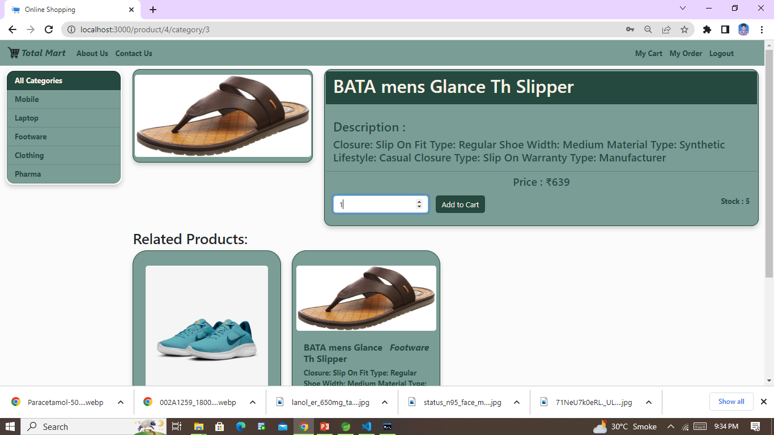
Customer home page and other like add to cart, order details etc.

Slide 22
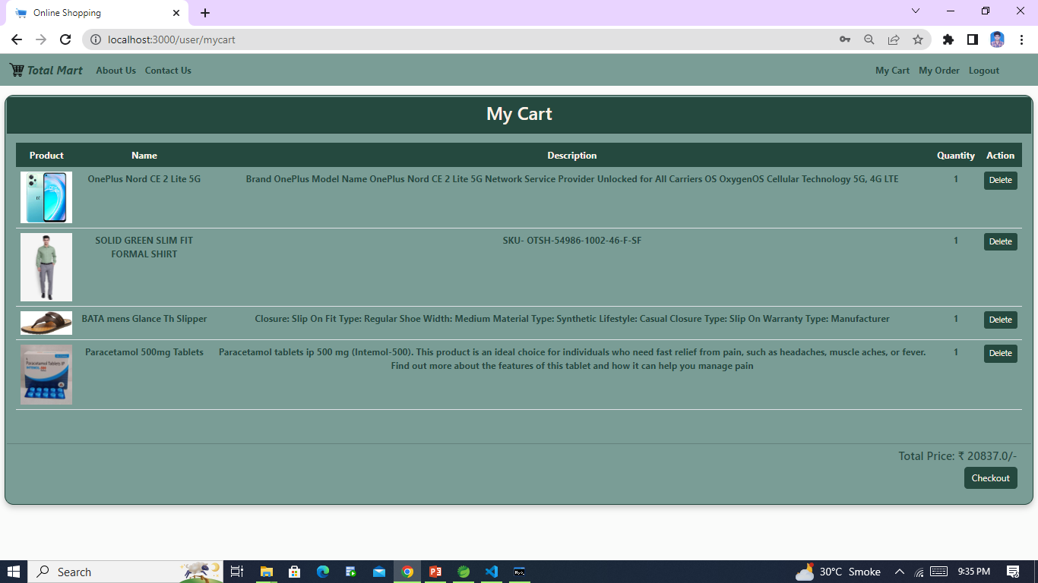
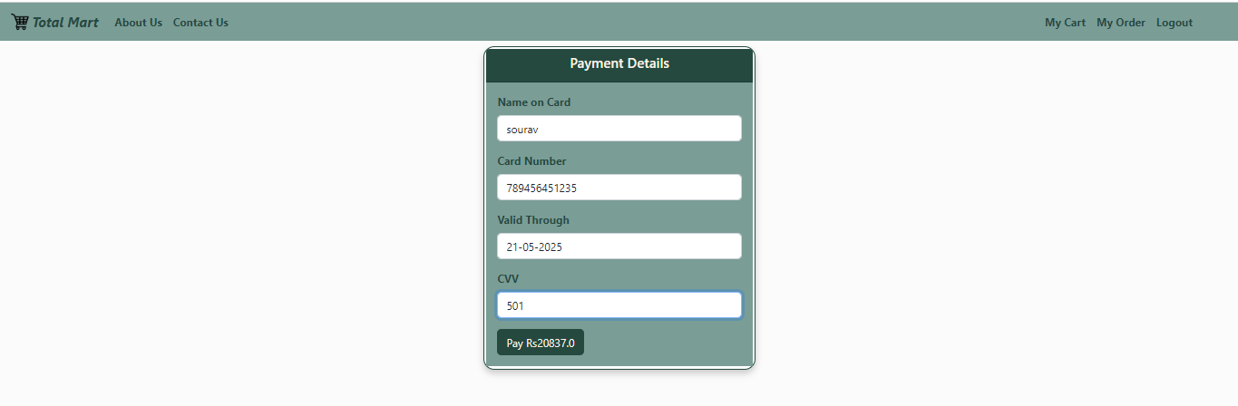
My cart and Payment

Slide 23
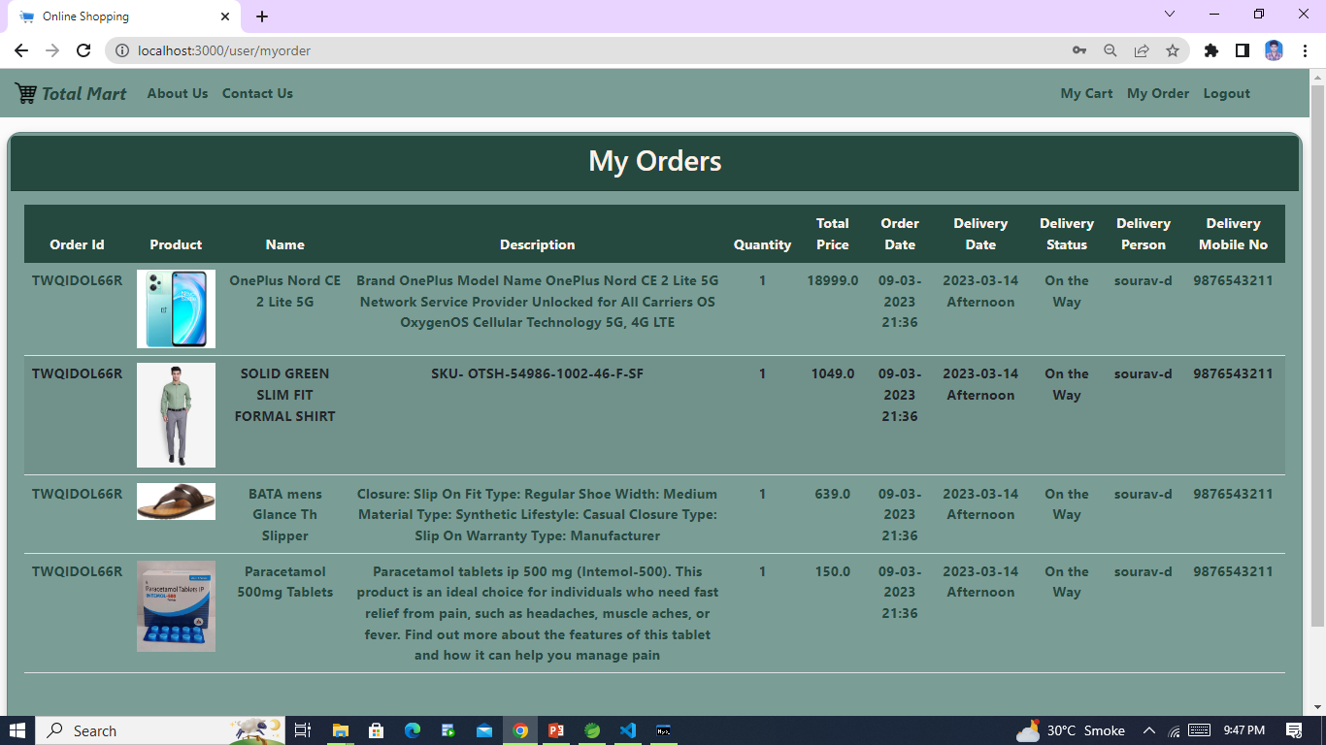
Customer can see their orders

Slide 24

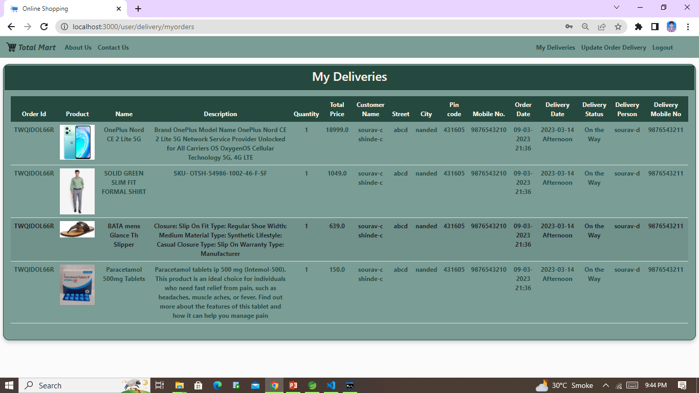
Deliver persons home page, he can check his deliveries and update status of delivery.

Slide 25
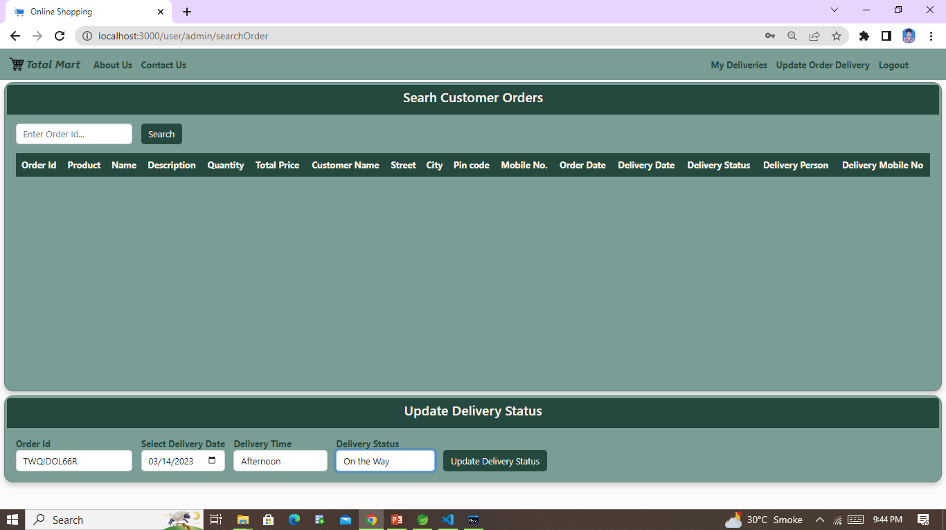
Delivery person updating delivery Status

Slide 26
Future Work
We are thinking of some modifications and adding some advanced new features in our system. Some of them are-
GUI Modification (more user friendly)
Allowing users to sell their products
Users can sing up/login using their social media account such as facebook, google+ etc.

Slide 27
Conclusion
So “Total Mart” is an web application that allows customers to buy products online. And admin can monitor the activity of user and the delivery person. And it also allows delivery person to update delivery status which can be visible by both user and admin.

Slide 28
References
Maven Dependencies :- https://mvnrepository.com/repos/central
Spring-boot framework :- https://start.spring.io/
React JS :- https://reactjs.org/docs/create-a-new-react-app.html
MySQL database :- https://www.w3schools.com/MySQL/default.asp

Slide 29
THANK YOU……!

